Slide 1
Polarion Implementation Project
Risk Management Module
Consumer Eye Health
September 2022

Slide 2
What has changed from Siemens maturity review?
All report configuration changed to match Vision templates.
All work item definition changed to match Vision data structure.
All label names changed to match Vision terminology.
Summary
The Polarion configuration is changed to match Vision processes.

Slide 3
Outline
Fundamentals
Polarion data objects
High level process definition
Discussion on Polarion deliverables
User interaction with Polarion
Demo Part 1
MHES report
Existing device risk management file
Demo Part 2
NPD project risk management file
Polarion data model for CEH deliverables 5-7 min

Slide 4
Fundamentals

Slide 5
What is Polarion ALM system?
What is Polarion ALM system?
The system is in essence a document creation and management tool used to efficiently author, link and track ideas and concepts.
Agile | Polarion
Document Management System | Data Management System
Every document has unique identifier and is version controlled. | Every data object has a unique identifier and is version controlled.
Documents are called items. | Data objects are called work items.

Slide 6
What is work item? Why is it used?
Work Items represent various artifacts - for example failure mode, hazardous situation, harm. Each artifact type is represented in Polarion by a Work Item type.
Each work item has multiple fields for user input, such as,
Author
Title
Description
Project
Approval status
Etc...
All the data referenced in the PRTM, FMEAs or Risk Assessments are stored in Work Items.

Slide 7
Document vs Report
 | Document | Report
Definition | Documents (or LiveDocs) are document-like containers for both free-form text and granular Work Items. (think MS Word) | Report Page (or LiveReport) are custom-built layouts for a report with charts that retrieve, aggregate, and/or format Work Item and other project data.
OOTB Redlining feature | Document has OOTB redlining feature. | LiveReports do not have OOTB redlining feature.
Traceability tables and data tables | Document do not support traceability matrices. | Report can be custom built to support traceability matrices
Use | All banner pages are configured using Documents. | All traceability matrices and data tables are custom built using LiveReports.

Slide 8
Process definition
User input
Polarion generated outputs
Deliverable
Banner page
Codeless LiveDoc
(Polarion word editor)
LiveDoc or Document exported as pdf
Graphical User Interface
(or)
LiveReport or Report
exported as pdf
Data as attachment
Direct bulk import
(or)
Codeful report

Slide 9
Project Architecture

Slide 10
Polarion System Architecture
JJSV Equipment and software only
VISION Equipment and software MASTER
*VISION Equipment Dev
Project 2
JJSV implantable
VISION Implantable MASTER
JJVC CEH
*VISION CEH Dev
JJVC Contact lens
Project 1
Project 2
VISION CEH MASTER
Project 2
VISION Contact lens MASTER
Project 1
Project 2
Configuration
Maintained by Polarion Project team
Master List Polarion Project
Maintained by VISION Project admin and Quality group
NPD projects
Maintained by Vision Project teams
*Temporary project names assigned in Development server.

Slide 11
Project Architecture
What is Master JJVC CEH project?
All data that are common across all CEH products are stored in Master JJVC CEH Project.
MHES table content
ISO Standards
Standard handbook data
How is Master JJVC CEH used?
Project teams can refer the Master JJVC CEH project data (like MHES table) to create project specific deliverables (like fmea).
Why is Master JJVC CEH used?
Consistency
Ease of use

Slide 12
Polarion Deliverables- Demo

Slide 13
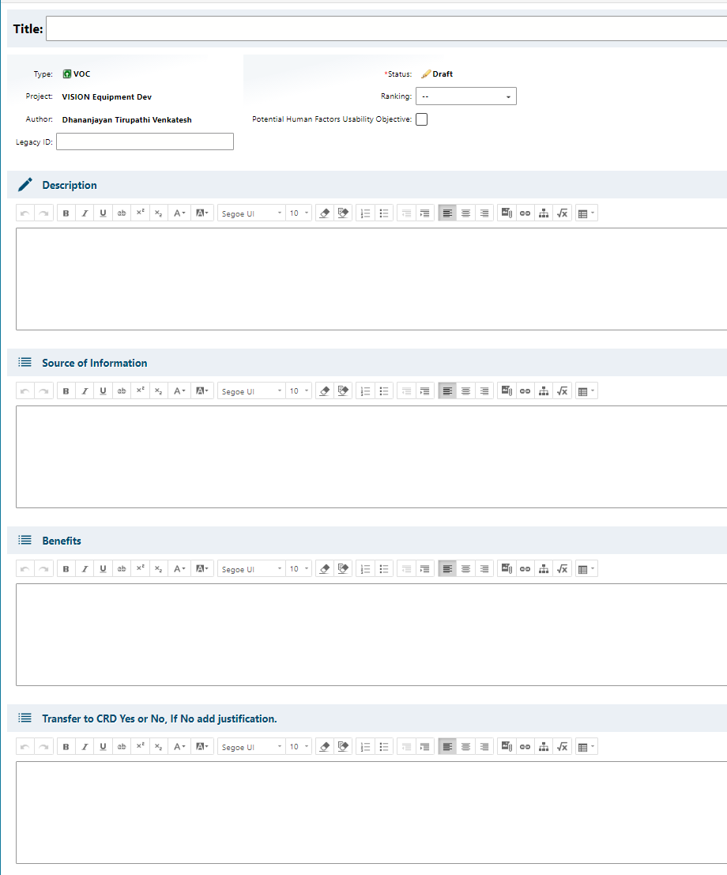
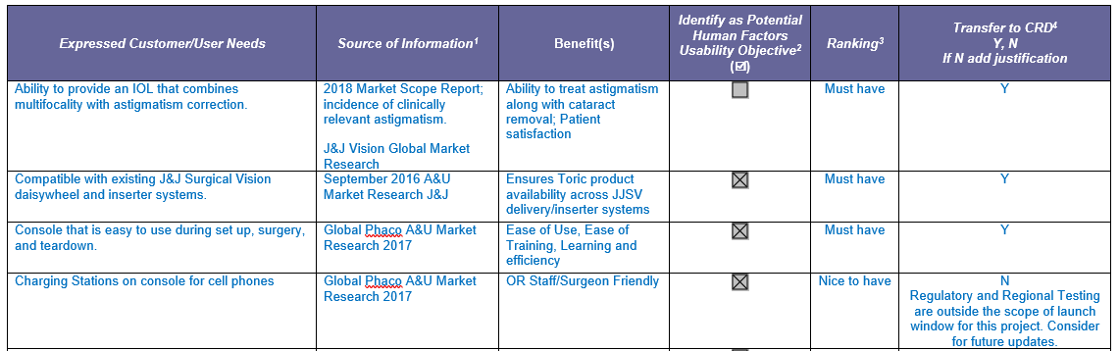
User experience
Polarion Work Item Screenshot
Objectives
User friendly.
Design per user actions.
Approach
Mimic the CEH processes and templates as-is.
Example- VOC Work item definition
VISION Template Screenshot

Slide 14
Process definition
User input
Polarion generated outputs
DHF deliverable
Banner page
Codeless LiveDoc
(Polarion word editor)
LiveDoc or Document exported as pdf
Graphical User Interface
(or)
LiveReport or Report
exported as pdf
Data as attachment
Direct bulk import
(or)
Codeful report

Slide 15
Creation of Banner page
Create
Create using pre-configured templates
Edit the document
Save
Save the document
Export
Export pdf and redline version
Edit
Demo- dfmea in CEH Dev
The templates in the Polarion system are maintained current by the Polarion Project team.

Slide 16
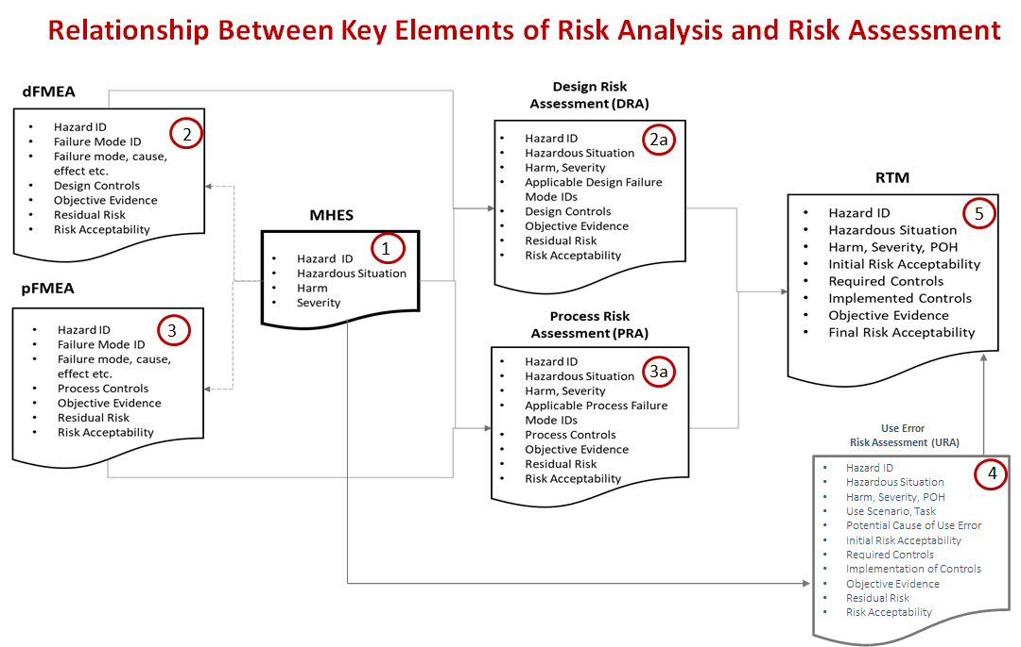
CEH RMF Polarion deliverables
RMR
Risk acceptability matrix
6
Key takeaway
All deliverables have been configured.

Slide 17
Creation of report page
Import
Import work items with links in bulk
Edit
Edit work items and links
Create
Create new work items and links
Export
Export pdf and redline version
Approve
Approve work items
Legacy products
The reports are configured and maintained by the Polarion Project team.
The DHF deliverables will continue to the approved in the PLM systems. Approval process is not in-scope for Polarion implementation. The approval process in Polarion is a ‘nudge’ to minimize user errors.

Slide 18
Demo- Phase-1 Import legacy existing data
Sample data used for demo
Blink- DHF9587X.
Demo Process-
Show the MHES table in the Master CEH project.
Show the risk files that are downloaded from in the CEH Dev project.
Show creating new WIs in new project
Show bulk import of linked WIs in new project.
Data from multiple risk files can be imported together.
Data sample size does not matter.

Slide 19
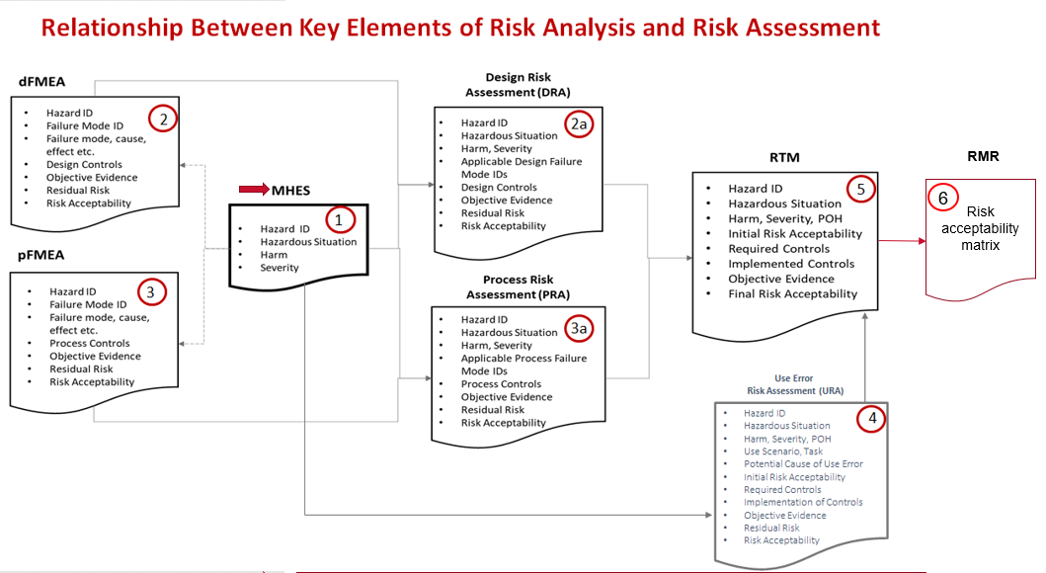
Creation of NPD project
New Polarion project
Harms data from MHES table
Failure mode and other data from existing device
Make updates

Slide 20
Demo- Phase-2 Create new RMF
Data used for Demo
Include the new harms/hazardous situation for new project.
Demo Process-
Show the MHES table stored in the Master CEH project.
Show the new project in sandbox.
Move the data from CEH Dev to new project.
Will create new Harms, Hazardous Situation in Master CEH project.
Will add new Failure modes to new project and link to the new Harms, Hazardous situation in Master CEH project.

Slide 21
Reuse Work items - Process
Step 1- Collect Work items using Polarion Move feature
Step 2- Copy to new project using Reuse feature
Existing Project
New Project
Work Item 1
Work Item 2
Work Item 3…
Document

Slide 22
Polarion Deliverables for CEH- Risk files
Template Title, number and revision | Banner page | Read-only report | Editable report
DFMEA | Done | Done | Done
PFMEA | Done | Done | Not configured. Pending feedback
Design Risk Assessment | Not applicable | Done | Not configured. Pending feedback
Process risk Assessment | Not applicable | Done | Not configured. Pending feedback
Use Error risk assessment | Done | Done | Not configured. Pending feedback
Risk Trace Matrix | Done | Done | Not applicable
Risk Management report | Done | Done | Not applicable

Slide 23
Training and lifecycle support from Polarion team
Notes:
This section should be left as is for now, TBD

Slide 24
Polarion process- Tentative transition plan
Until Dec 2023
Polarion Project admin to create the Polarion project
2024 and beyond
Polarion Project admin to create the Polarion project
Project users create, edit and modify project data
NPD Project team identifies users for the Project.
Polarion project team upload legacy data
NPD Project team identifies atleast one project owner
NPD Project team identifies users for the Project.
NPD Project team identifies atleast one project owner
Project users upload legacy data
Project users create, edit and modify project data
Training provided by Polarion Project team
In-person training
Video conference
ComplainceWire
Training videos

Slide 25
Data model

Slide 26










Polarion Work Items for CEH Risk files
Function/ Use Scenario
classifies
classifies
Design/Process Requirement
Use Step
evaluates
evaluates
Hazard
exposes
leads to
Hazardous Situation
Failure Mode
causes
causes
Harm
has Risk Record of
Cause of Failure
Harm Probability
controls
Risk Control
Example- Label changed to match Vision terms.
Key takeaway
The data model configured to match CEH processes and deliverables.

Slide 27
Validation

Slide 28
Validation approach
IT validation
VISION specific customization validation
Total Validation package
Completed by Dave and Siemens Team.
Scope include but not limited to-
Server data back up
Disaster recovery processes/ requirements
Security management login testing/security breach etc.
Completed by Danny and TCS Team.
Scope include but not limited to-
Work items fields
Reports
Banner page set-up
QMS Procedures/Work instructions/training
User Acceptance Testing

Slide 29
Back-ups

Slide 30
Creation of report
Polarion data model
Failure mode
Cause of Failure
Harm
Other WIs
Hazardous situation
Create links

Slide 31
FAQs
FAQs | Responses
Can the report be configured to display work items in draft mode? Approval in Polarion is a non-value add step. (or) Why does the report display only approved work items? | This is nudge for the user to check the data entry atleast once before exporting to pdf. As the user community matures, this non-value step can be removed.
Why is banner page (cover page) configured in live doc and data table is configured in LiveReport? (or) Why are there two separate files configured in Polarion for every deliverable? | For every deliverable, a decision must be made to either use LiveDoc or LiveReport for configuration. This decision is driven by the type of data in the deliverable. The data in the banner page (cover page) is free form text. This is fundamentally different from the type of data in the traceability table, like PRTM. Every piece of data in the traceability table must have a unique identifier and must be traced across multiple documents. LiveDoc is the best suited for deliverables with free form text. Customized LiveReports is the best suited for traceability tables.

Slide 32
Questions and follow-ups
Question/ Description | Status

